Slide 1
Springboard Capstone Presentation
By Joshua Karpen
Predicting Price and Utilization of AirBnB Listings

Slide 2

The Problem
AirBnB pricing recommendations not transparent
Customers want to find the best deals
Hosts want to know the best price to charge to attract customers
Insert-Data-Science-is-the-Solution-To-Everything-Quote-Here

Slide 3
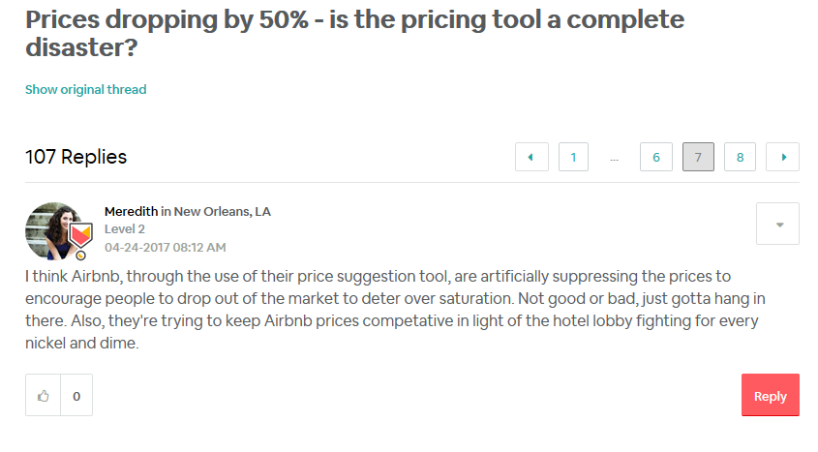
The Problem

Slide 4
How can Data Science Help?
Goal: To help AirBnB hosts find the best price to set their listing at to meet a desired utilization rate
What price can I set my listing to ensure it is filled at least 50% of the time?
This is a prediction problem – we can predict the price of a listing based on various factors
Then, we can predict the utilization of the listing based on how close the actual price is to the predicted price
Theory to test: An over-priced listing will be booked less often. An under-priced listing will be booked more often.

Slide 5


Data Availability
AirBnB data scraped regularly by Inside AirBnB, for most major cities
Listing details, like # bedrooms, bathrooms, daily price, property type, bed type, and ~ 40 more variables including lat/long (generalized to within a few hundred feet)
Calendar and Review data – not used – focused on helping new hosts first, likely do not have any reviews yet
Yelp releases a dataset annually with facts about businesses in a small number of cities.
Type of business, ratings, lat/long
Used to enrich AirBnB data – how many businesses and how popular are they, within a certain radius of each AirBnB listing?
Notes:
http://insideairbnb.com/
https://www.yelp.com/dataset

Slide 6
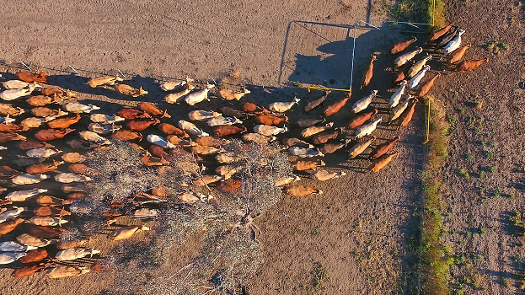
Fixing Data Quality Issues (Data Wrangling – YeeHAW!)

Slide 7
Data Quality Issues
Lots of null values, outliers
Some columns only one value
Missing values – some missing entirely, some missing partially
If > 50% missing, dropped entirely
Otherwise imputed
Need to combine ~30 Property Types
Anything below threshold grouped into “Other”
Neighborhood names did not match between AirBnB and Yelp
Manual consolidation

Slide 8
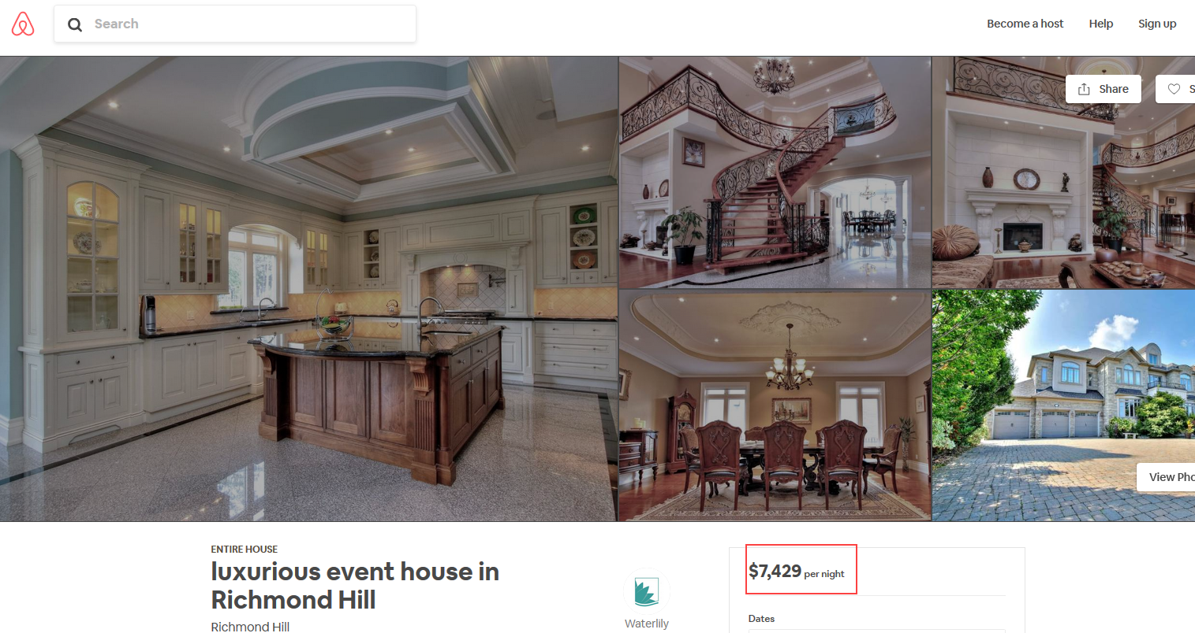
Outliers - Price
A handful of listings had an extremely high price – $3K-$12K (per night!)
These are not representative of most listings, so I decided to exclude

Slide 9
Data Quality Issues - Merging AirBnB and Yelp data
Joined on Neighborhood
AirBnB listings duplicated for each Yelp restaurants/bars in same neighborhood
First had to clean neighborhood names so they matched
Calculated distance between each listing and each Yelp business
Summarized to determine # restaurants/bars w/in .1 mile and .5 mile of each AirBnB listing

Slide 10

Exploratory Data Analysis

Slide 11
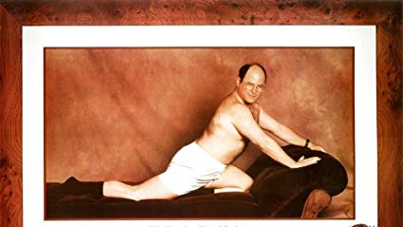
Modeling

Slide 12
Model Chosen & Why

Slide 13
Results

Slide 14
Recommendations

Slide 15
Suggestions for Improvement/Next Steps

